Slide 1

My journey to Data science, big data and AI
Patrick Lee FIA (to SIAS, 7 Jan 2020)

Slide 2
Three areas, closely interrelated
Data science
Big data
AI

Slide 3
overview

Slide 4
My goals today:
Give each and every one of you something you can take away to advance you in your career
Pointing you towards useful toolkits to help you extract more value from data for your employers and society
Raising some questions that I hope will spark your interest and set you off on your own, thrilling journey

Slide 5
Aim to cover
Background
MOOCs (Massively Open Online Courses)
Introduction to (and different areas covered by):
Data science
Big data
Artificial Intelligence (AI)
Suggested toolkits:
  SQL
  Excel
  Azure and other notebooks
  Visual Studio …
Some challenges, and ethical issues
Some questions to get you thinking/stimulate debate

Slide 6
background

Slide 7
My background
Pensions and investment actuary at the start of my career
Software developer
pensions valuation
stochastic investment models
income projections
general business / data management
-> web / cloud / data / AI / Devops
I hold Microsoft Professional Program Certificates in Data Science, Big Data and AI
Maths graduate / stats diploma
R Watson & Sons/Watson Wyatt then
InQA Limited
Zupatech then
CADS Ltd (Computer and Design Services Ltd)

Slide 8
MOOCs

Slide 9
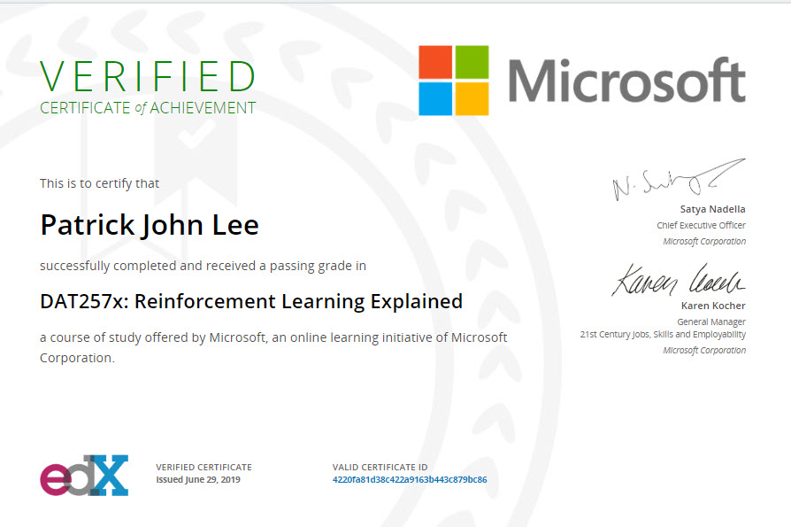
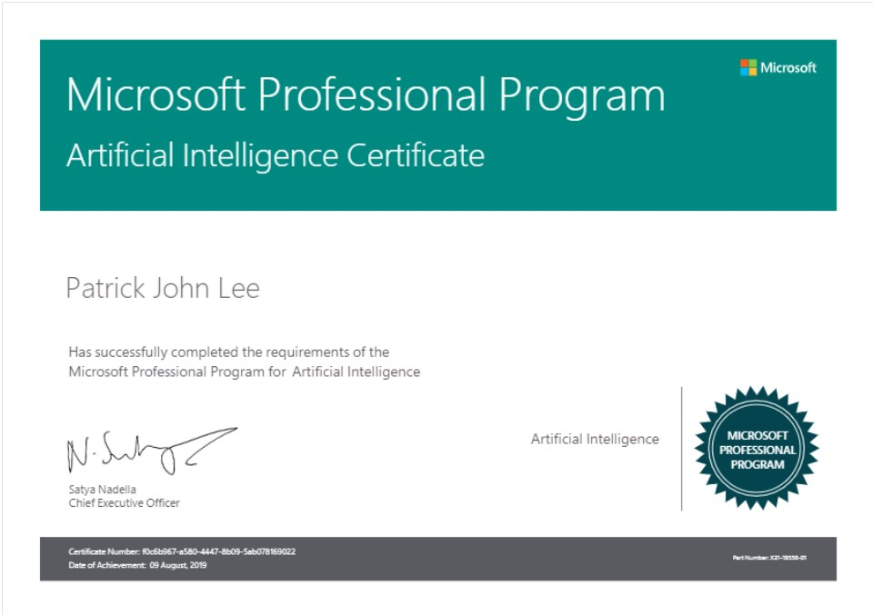
Why use MOOCs?
Pros
Convenient
(Relatively) Cheap (e.g. $99 per course for edX)
Wide range
Certifications available
High marks possible
Cons
You’re largely on your own (despite discussion forums)

Slide 10
Data science

Slide 11
“Data Science”: my understanding
Cleaning, manipulation and analysis of data
Statistics
Presenting results to get business information
Management insights

Slide 12
Microsoft Professional Program for Data Science: 10 courses
Data Science Orientation
Microsoft Querying with Transact-SQL (T-SQL)
Analysing and Visualising Data with Power BI
Essential Statistics for Data Analysis using Excel
Introduction to R for Data Science
Data Science Essentials
Principles of Machine Learning
Programming with R for Data Science
Analysing Big Data with Microsoft R
Capstone Project: Predicting Earthquake Damage in Nepal

Slide 13
For more details of the Data Science program
Some aspects shown in this presentation, but for more info:
see https://pjlee.net/blog/microsoft-professional-program-for-data-science-my-journey-may-2017-april-2018

Slide 14
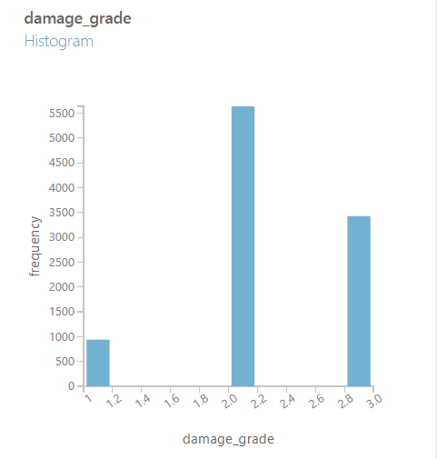
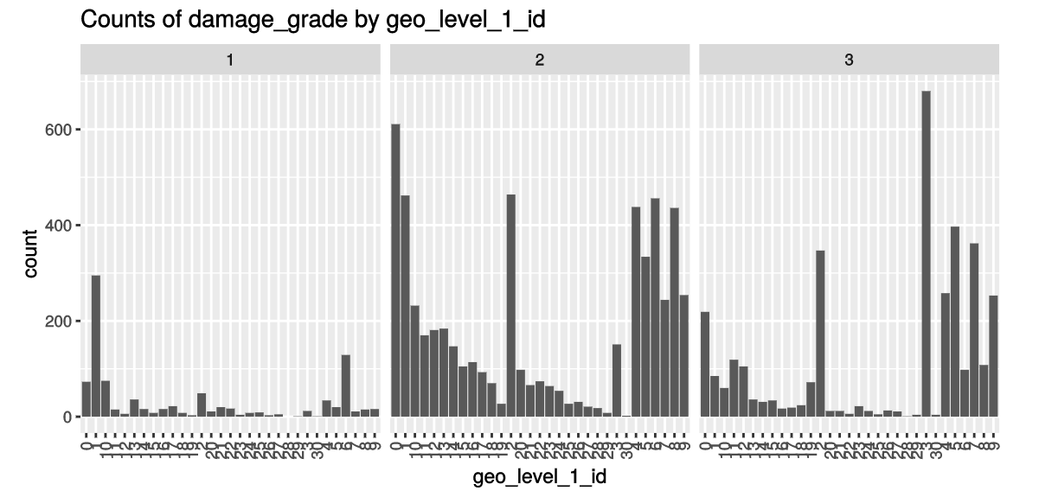
Capstone project: data science competition: predicting earthquake damage in Nepal

Slide 15
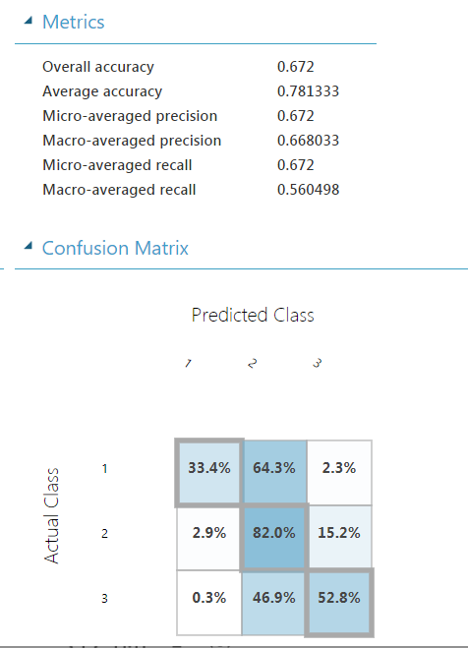
Capstone project: predicting earthquake damage in Nepal
My model: a multiclass logistic regression, fitted using Microsoft Machine Learning Studio

Slide 16
Big data

Slide 17
“Big Data”: my understanding
Dealing with more difficult / diverse/ large / fast data
Essentially a computing problem
Probably cloud

Slide 18
Microsoft Professional Program for Big Data: 10 courses
Big Data Orientation
Analysing and Visualising Data with Power BI
Introduction to NoSQL Data Solutions
Microsoft Querying with Transact-SQL (T-SQL)
Implement a Data Warehouse
For more details see https://pjlee.net/blog/microsoft-professional-program-for-big-data-my-journey-oct-2017-apr-2019
Process Big Data at Rest
Process Big Data in Motion
Orchestrate Big Data Workflows
Analysing Big Data with Microsoft R
Capstone Project

Slide 19
Big data capstone project
3 three separate challenges that tested my ability to build Big Data solutions for:
processing data at rest (processing one week’s stock inventory data to add it to a data warehouse)
processing data in motion (real-time stock adjustments from a simulated chain of retail stores, aggregating it over non overlapping one-minute intervals and analysing the results.)
orchestrating Big Data solutions (using Azure Data Factory to load data for each store and each week for a full year into a data warehouse and then analysing the output)

Slide 20
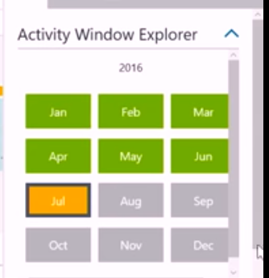
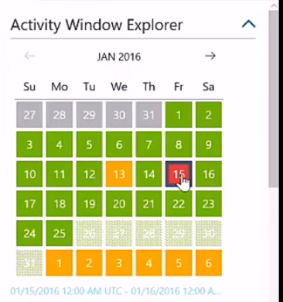
Orchestrating a big data solution using Azure Data Factory
Azure Data Factory keeps checking whether a data file/source has become available, and when it has it carries out the next step in the processing pipeline

Slide 21
Artificial intelligence (AI)

Slide 22
“AI”: my understanding
Essentially applying models that are tailored to computers’ strengths
Much harder for humans to understand
Algorithms include deep neural networks, decision tree forests
Often require big data because the number of parameters can be huge

Slide 23
Microsoft Professional Program for AI: 10 courses
Introduction to AI
Introduction to Python for Data Science
Essential Mathematics for Machine Learning
Ethics and Law in Data and Analytics
Data Science Essentials
Principles of Machine Learning
Build Deep Learning Models
Build Reinforcement Learning Models
Computer Vision and Image Analysis
Capstone Project

Slide 24
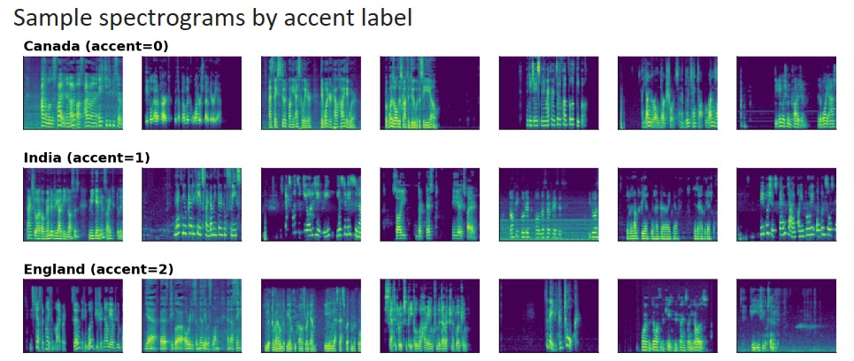
AI Program capstone course: classifying speech accents
Given spectrograms from sound files
Task: correctly classify them into Canadian, Indian and English accents

Slide 25
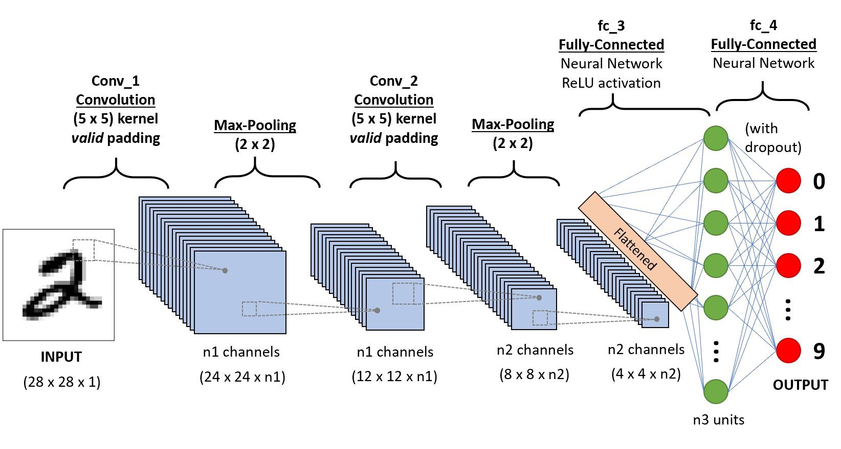
My eventual solution
Example of a CNN model
A CNN model ( Convolutional Neural Network)
Using Google Co Labs

Slide 26
Suggested toolkits

Slide 27
Some toolkits I have found useful
  Microsoft Excel
  SQL (Structured Query Language) in SSMS (Sql Server Management Studio)
  Microsoft Power BI
  Azure (Jupyter) notebooks
  Microsoft Visual Studio
  Azure Machine Learning Studio
  Azure Storage Explorer
  Azure Portal (dashboards)
  Google CoLabs

Slide 28
Microsoft Excel

Slide 29
Microsoft Excel: Pivot Charts and tables + more
A very useful, flexible tool for:
quick, ad hoc data analysis
Presentation to senior management
Don’t underestimate the power of humble Excel for quick and dirty analysis

Slide 30
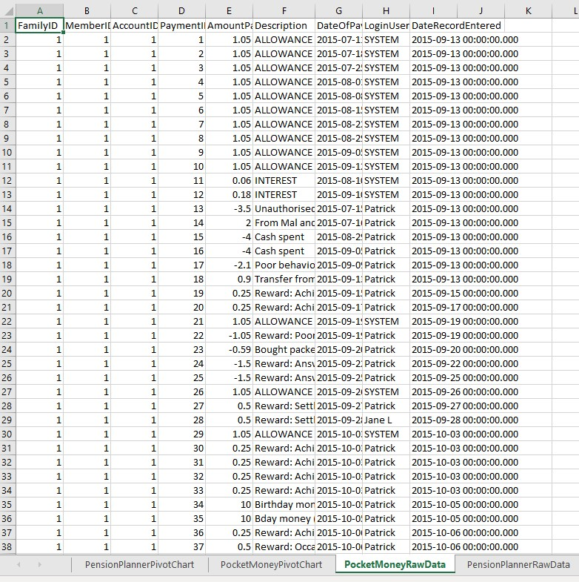
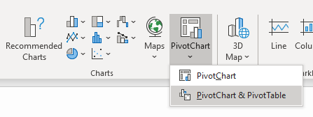
Raw data table in Excel
Select any cell within the table
From the ribbon click
Insert, Pivot Chart, Pivot Chart & Pivot Table

Slide 31
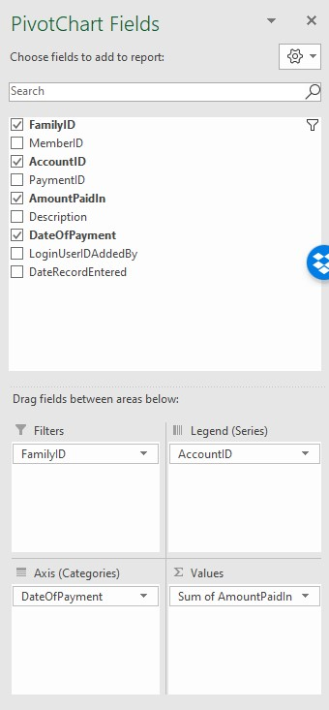
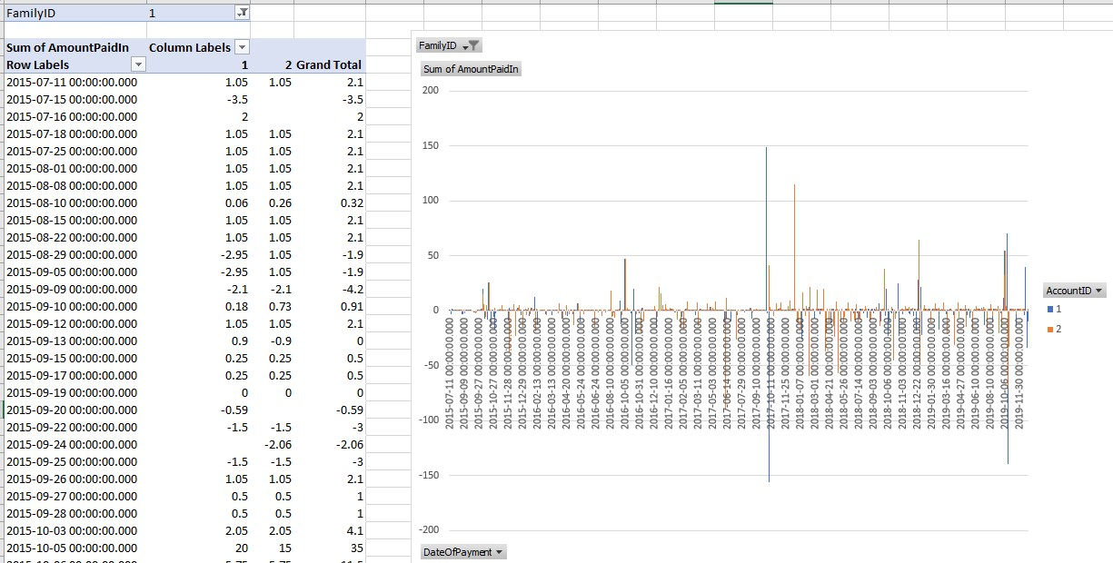

Slide 32
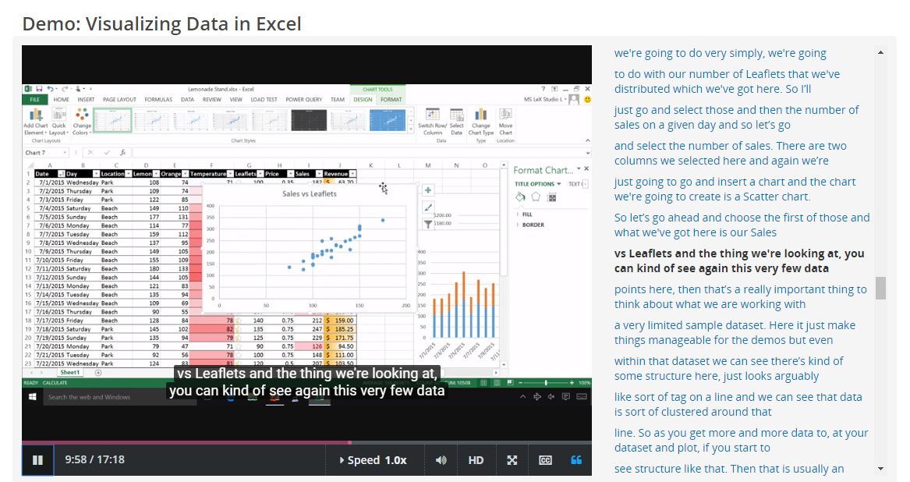
Excel has rich visualisation facilities to help you extract insights
… and communicate them to clients/senior management!

Slide 33
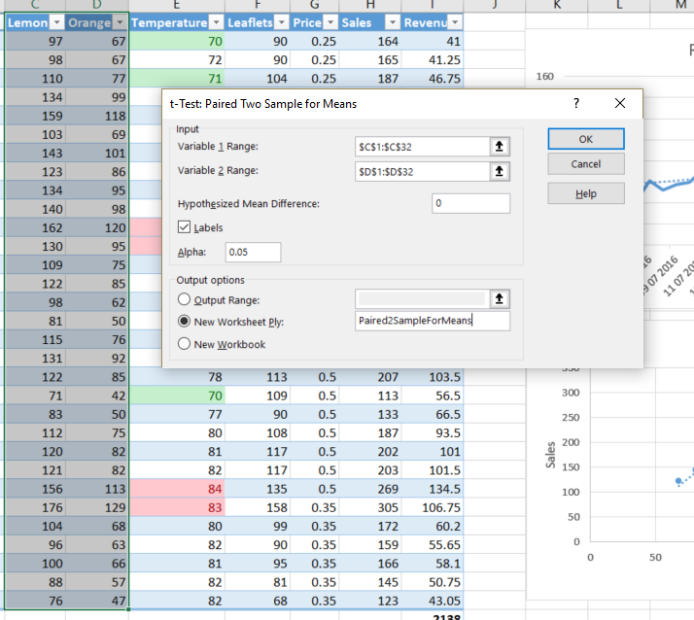
Excel also allows you to do simple statistical tests for hypothesis testing

Slide 34
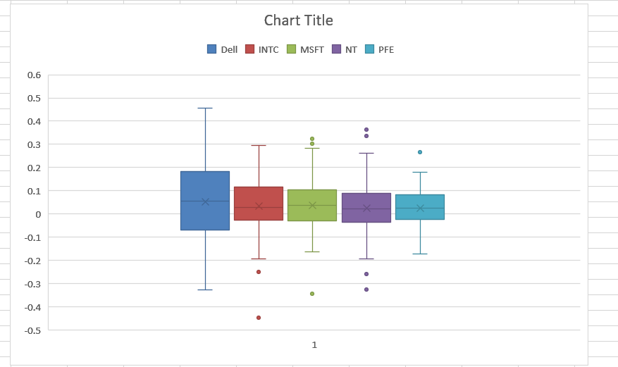
Excel also allows you to produce Box and Whisker charts and other statistical analysis (e.g. Pareto charts, tree view charts)

Slide 35
Excel: pros and cons
Pros
Cons
Quick and easy
Easy to share with less technical colleagues/clients
Difficult to access protected data securely
Hard to produce multiple charts
Poor quality control
Hard to detect errors
Quite a lot of work to do interactive dashboards
Lots of Vlookup queries to relate data (but PowerPivot helps a bit…)

Slide 36
SQL

Slide 37
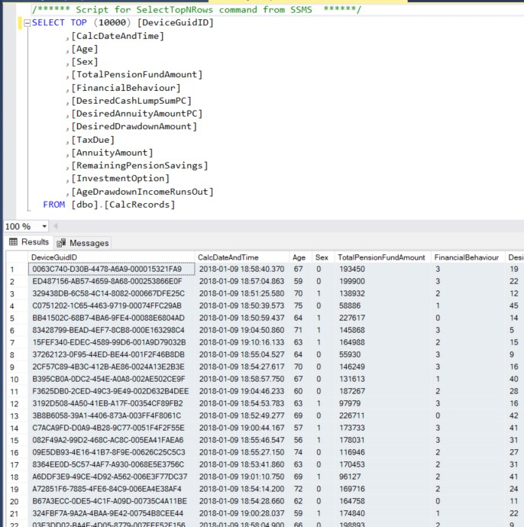
Simple SQL query in SSMS
SSMS : Microsoft Sql Server Management Studio

Slide 38
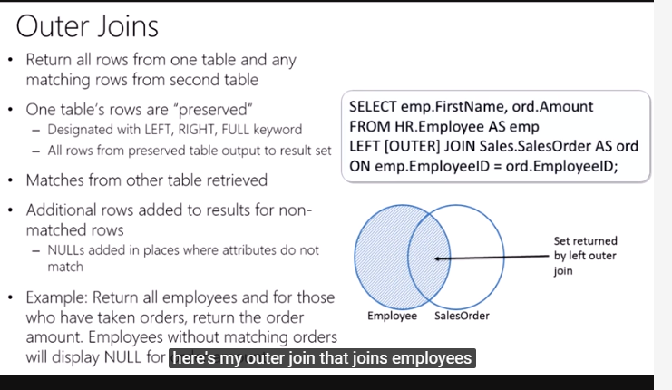
SQL (Structured Query Language)
A more professional/reproducible way of extracting data
Very useful to combine data from different sources
Can be applied to objects in memory in code not just data (e.g. via LINQ in .Net or Javascript)

Slide 39
Run powerful, complex queries across multiple tables (e.g. using Derived Tables)
select DeviceId, SiteName1, SiteName2 from
(select query1.DeviceId, query1.SiteId as SiteId1, query1.SiteName as SiteName1, query2.SiteId as SiteId2, query2.SiteName as SiteName2 from
(select table1.DeviceId, table1.SiteId, SiteName from
(SELECT DeviceId, SiteId
FROM Devices join SiteAreas on Devices.SiteAreaId = SiteAreas.SiteAreaId) As table1
join Sites on Sites.SiteId = table1.SiteId) As query1
Join
(select table2.DeviceId, table2.SiteId, SiteName from
(SELECT DeviceId, SiteId
FROM Devices join Contracts on Devices.ContractId = Contracts.ContractId) As table2
join Sites on Sites.SiteId = table2.SiteId) As query2
on query1.DeviceId = query2.DeviceId) as CombinedQuery
where SiteName1 != SiteName2

Slide 40
SQL: use variables to run successive queries
DECLARE @varContractId uniqueidentifier;
select @varContractId = MAX(ContractId) from Contracts inner join Sites on Sites.SiteId = Contracts.SiteId where Sites.SiteName = 'put address here'
DECLARE @varDeviceId uniqueidentifier;
select @varDeviceId = MAX(DeviceId) from Devices inner join Contracts on Devices.ContractId = Contracts.ContractId
where Contracts.ContractId = @varContractId
select * from DeviceLogs where DeviceId = @varDeviceId order by AppliedWhen desc

Slide 41
Microsoft Power BI

Slide 42
Microsoft Power BI (Business Intelligence)
(NB not free)
Easy sharing of dashboards
Easy for senior management to use/interact with
Natural language query facility
Easy to apply the same filter to lots of different charts/tables quickly
An alternative to doing bespoke websites

Slide 43
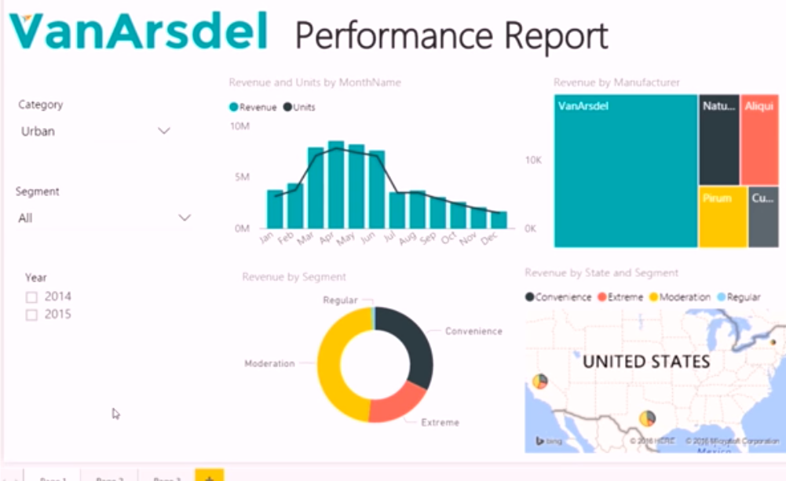
Very interactive
As you apply filters in the dropdown lists, all charts update consistently
Similarly if you select a manufacturer in the Tree View

Slide 44
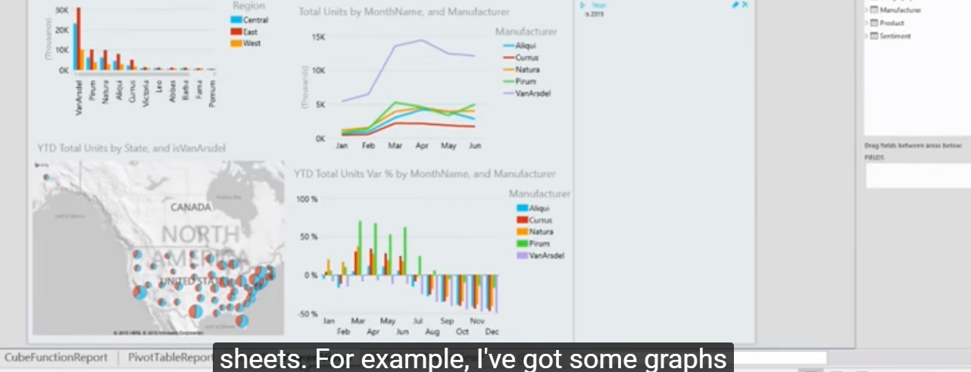
Charts can include interactive maps

Slide 45
Jupyter notebooks

Slide 46
Jupyter notebooks: notebooks.azure.com
Free online platform to run R or Python
Allows you to include documentation with your code
Includes tools to access a wide range of data sources
Visualisation tools also included

Slide 47
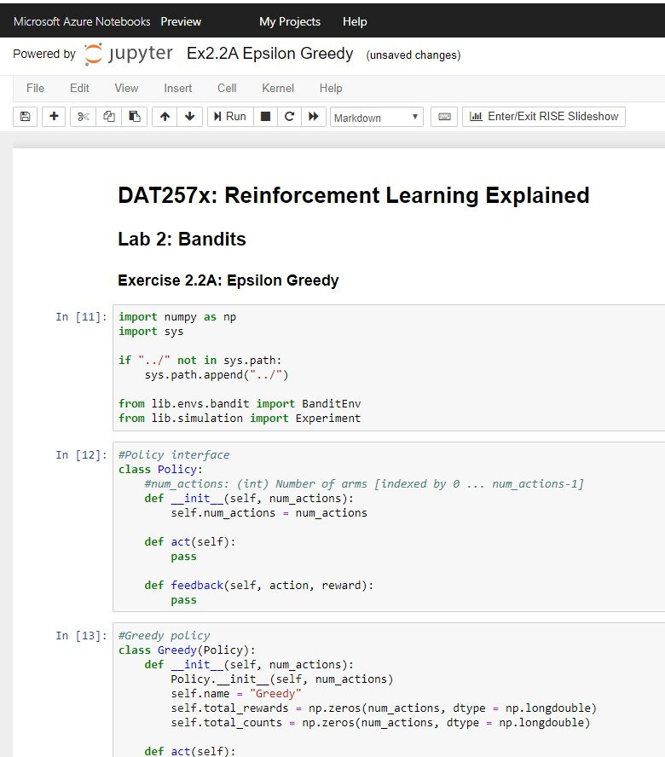
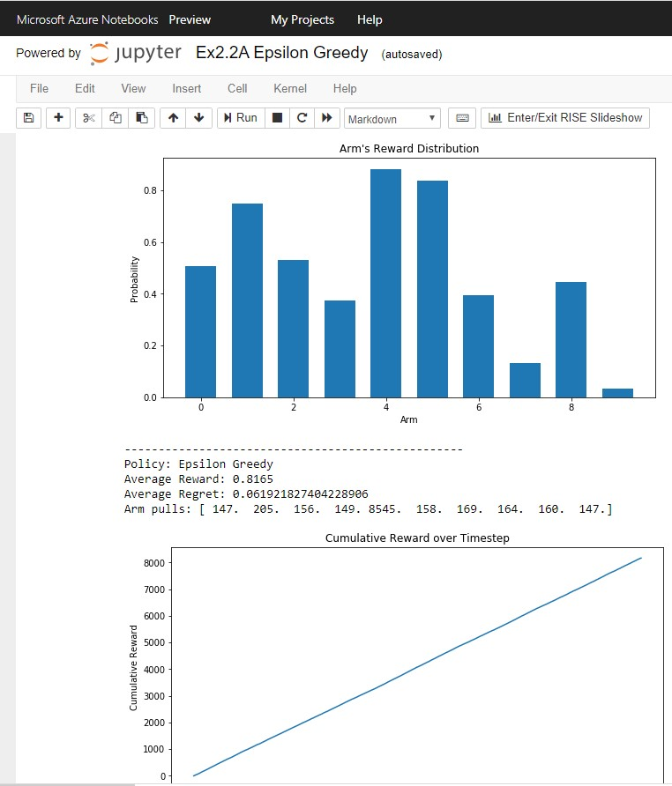

Slide 48
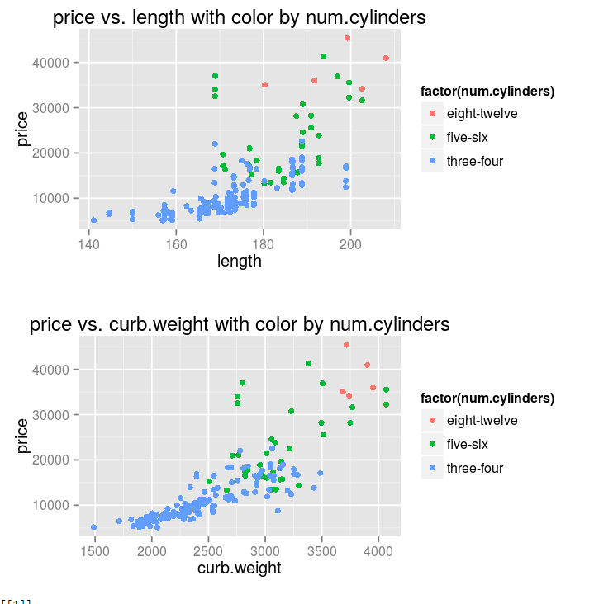
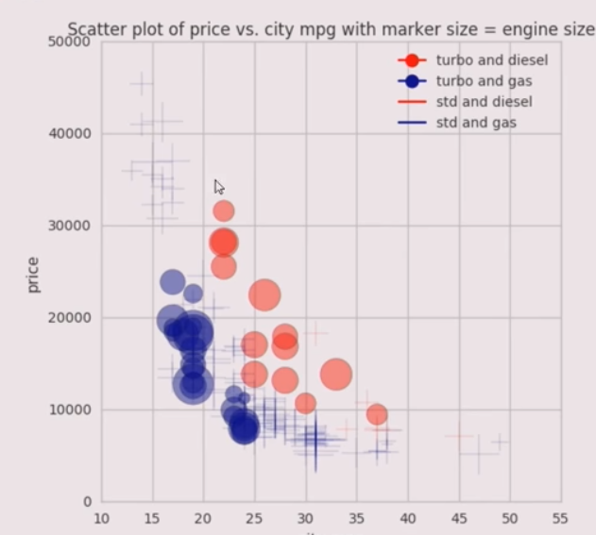
Example of useful visualisation in a notebook (predicting the price of a car)
Uses faceting: adding extra dimensions to a 2D chart via colour (but can also use different shapes, point sizes etc)

Slide 49
Microsoft visual Studio

Slide 50
Microsoft Visual Studio
Platform for professional coding
Allows more bespoke analysis
Can be R or Python, but (.net) C# (or VB.net)
Excellent integration with Microsoft’s Azure cloud/data platform

Slide 51
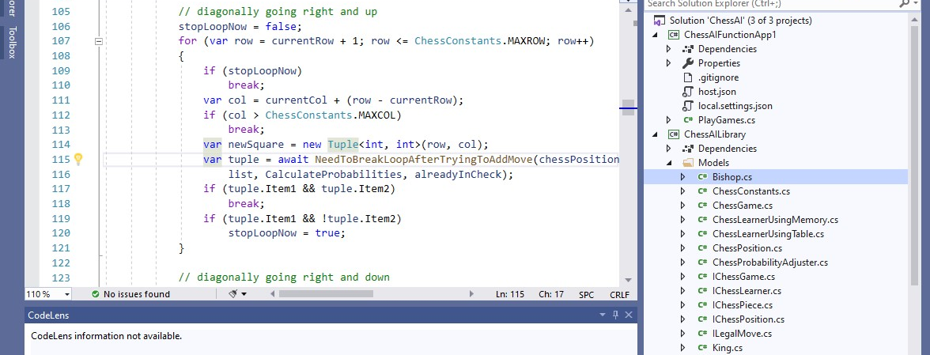
Microsoft DotNet Core 3.0: increasing support for machine learning via ML.net. Expect C# support to rival python/R libraries in time

Slide 52
Azure Machine Learning studio

Slide 53
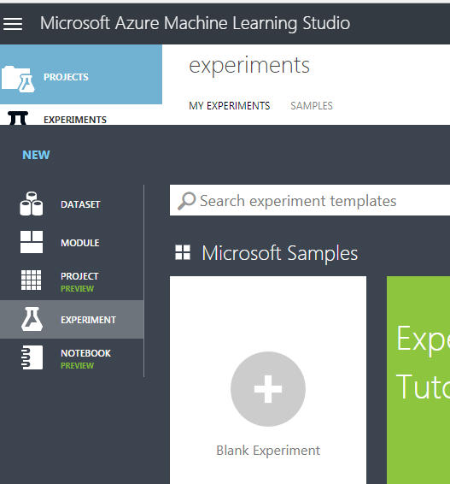
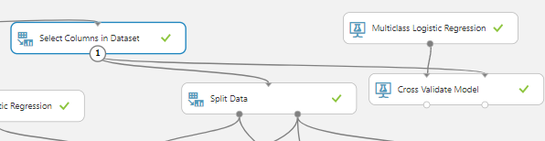
Microsoft Azure Machine Learning Studio
A good user interface for basic machine learning / data analytics

Slide 54
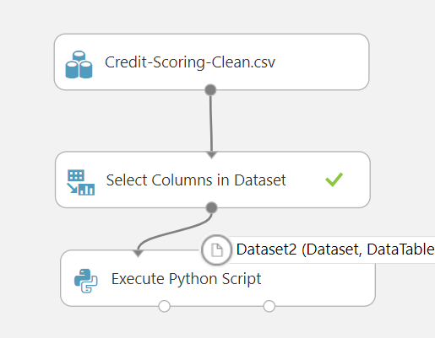
ML Studio: very user friendly data science
Drag and drop user interface for:
Data cleaning/manipulation
Choosing different models
Moving a trained model to production

Slide 55
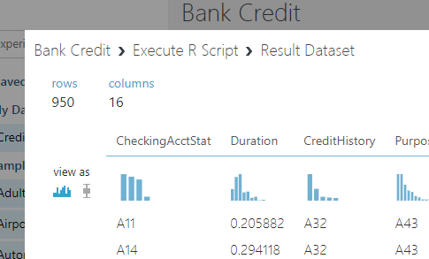
ML Studio: provides good initial overview of data
Statistical distribution of each column
Provides information about missing values

Slide 56
Overview of fit of model via Evaluate Model module

Slide 57
Some ethical issues

Slide 58
Some ethical issues
I served on the IFoA joint Data Science Focus Group with Royal Statistical Society
3 actuaries (Michael Tripp, Valerie du Preez and me), 2 RSS members (Leone Wardman and Giles Pavey) plus Leisha Watson from IFoA legal team
Looked at various previous ethical frameworks for AI
Tried to synthesise these into some guidance for IFoA and RSS members

Slide 59
IFoA/RSS guidance: 5 key principles
Seek to enhance the value of data science for society
Avoid harm
Apply and maintain professional competence
Seek to preserve or increase trustworthiness
Maintain accountability and oversight

Slide 60
Useful Resources

Slide 61
Useful resources
IFoA Certificate in Data Science (available 2020): https://www.actuaries.org.uk/news-and-insights/news/actuarial-impact-data-science
Online course providers: edX (https://www.edx.org/), Udemy (https://www.udemy.com/)
Microsoft Azure (12 months free): https://azure.microsoft.com/en-gb/
Microsoft Learn (online courses, many free): https://docs.microsoft.com/en-us/learn/
IFoA / RSS : A Guide for Ethical Data Science (https://www.actuaries.org.uk/upholding-standards/data-science-ethics)
IFoA Data Science hub: https://www.actuaries.org.uk/learn-and-develop/lifelong-learning/what-data-science-actuarial-viewpoint

Slide 62
Useful resources (contd)
Google Colabs (similar to Azure notebooks but using Google technology): https://colab.research.google.com/
Kaggle (data science competitions but also notebooks, and training courses): https://www.kaggle.com/

Slide 63
Some challenges

Slide 64
Some Challenges
Understanding Deep Learning Models (such as CNNs and more complex models)
The tradeoff between building in intelligence and throwing more computing and data storage power
Lots of ethical challenges (some questions coming up next…)
Tradeoffs between models running in the cloud, and ones running on a mobile (hence have to be able to run offline)

Slide 65
Some Questions

Slide 66
Some questions for you…
If an AI model is as good (or even better) at detecting cancer than human consultants, should be it used if it is not explainable?
If Nazi Germany had taken power in 2009 rather than 1933, and instead of trying to develop a nuclear bomb, was known to be trying to develop lethal autonomous weapons, should we (the US and Britain) race to develop them too?

Slide 67
Some questions for you…
Should NHS Trusts share data (as anonymously as possible) if this would enable AI models to detect rare diseases/dangerous drug side effects more quickly?
Should autonomous vehicles be programmed in the event of an imminent unavoidable fatal accident to minimise number of quality years life lost?

Slide 68
Some questions for you…
A major credit fraud detection agency wants to improve its model and runs a competition. How should it minimise the danger of fraudsters wising up to the most significant factors used to detect them?
Should law enforcement agencies be able to use people’s mobile phone location data to determine whether they were speeding?

Slide 69
Contact details

Slide 70
More questions? You can reach me at:
Email: Patrick.lee@inqa.com
Linked In: https://www.linkedin.com/in/patrick-lee-data-ai-software/
Blog: https://pjlee.net/

