Slide 1
Introduction to the MRSC
Sacha Dhamani and Matthew Edwards
5th November 2019

Slide 2
Disclaimer
The views expressed in this presentation are those of the speakers,
Sacha Dhamani and Matthew Edwards,
and not necessarily of the
Staple Inn Actuarial Society or Prudential and Willis Towers Watson

Slide 3
Summary of Presentation
What is the MRSC and what does it do?
What are the research priorities of the MRSC?
How do you get involved?

Slide 4
What is the MRSC?

Slide 5
What is the MRSC?
Established in 2006 and “is a group of actuaries and professionals from other disciplines who aim to advance mortality research through interaction and collaboration”
Reports to the Profession’s Research and Thought Leadership Publications Sub-Committee
The purpose of the MRSC is to:
  To contribute towards the Institute and Faculty of Actuaries (IFoA) becoming recognised as a leader in the research of mortality, morbidity and longevity issues.
  To support RTLC in ensuring that the IFoA Learned Society and Thought Leadership objectives as they relate to mortality, morbidity and longevity research are being delivered and remain appropriate.
  To provide a forum for raising mutually-applicable issues relating to mortality, morbidity and longevity research and champion their resolution within the IFoA or escalate them to the RTLC as appropriate

Slide 6
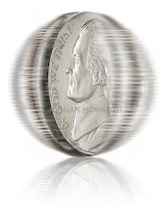
MRSC & CMI – Two sides of the same coin
MRSC
CMI
Seeks to stimulate research
Focuses more on the subjective
Concerned more with using information
Explores the usage of new methods
Provides practical tools
Focuses more on the objective
Concerned more with using data
Uses established techniques
Overall intent is the same – to support actuaries in the management of demographic risks

Slide 7
Who are the MRSC?
Current Members of the Committee
  Sacha Dhamani, Chair (Prudential)
  Dan Ryan (Swiss Re)
  Matthew Edwards (WTW)
  Phillip Simpson (Milliman)
  Adrian Gallop (GAD)
  George Stefaritis (Heriott-Watt)
  Jamie Marshall (Generali)
  Steven Baxter (Hymans Robertson)
  Tim Gordon (Aon Benfield)
  Charles King (PLR)
  Sarah Mathieson, Head of Research for the IFoA
  Ken Bogle, Committee Secretary

Slide 8
MRSC Mission Statement
To strengthen understanding of human longevity, mortality and morbidity by:
Leading world-class research in the areas of;
  Predicting future population mortality and morbidity improvement
  Managing risk in products providing longevity, mortality and morbidity protection
  Tools and techniques used for analysing portfolio experience
  Supporting the Profession's efforts to resolve the challenge of providing older age care
  Communication of complex risk behaviours in ways that are easy to understand
Providing a conduit for research activity through;
  Forging and maintaining relationships with other professional disciplines and academia
  Guidance in prioritising profession initiated research
  Maintaining oversight of emerging risks and developments relating to longevity, mortality and morbidity
  Dissemination of relevant research
  Contribution to the public debate concerning the effect of changing demographics upon society

Slide 9
Conduit for Research
RTLB
Profession
Contribution
Policy Makers
Public
Academics
Longevity Bulletin
Relationships
Dissemination
Government Bodies ( e.g. ONS)
Events (e.g. Symposium)
MRSC
International Bodies (e.g. IAA)
Guidance
MRSC Papers
Heads of “LMM”
Public Responses
CMI
ARC
MRSC MIG
Working Parties

Slide 10
What does the MRSC “produce”?
Longevity Bulletin
Mortality and Longevity Symposium
Ad hoc events
Mortality Hub Content
What else should it produce?

Slide 11
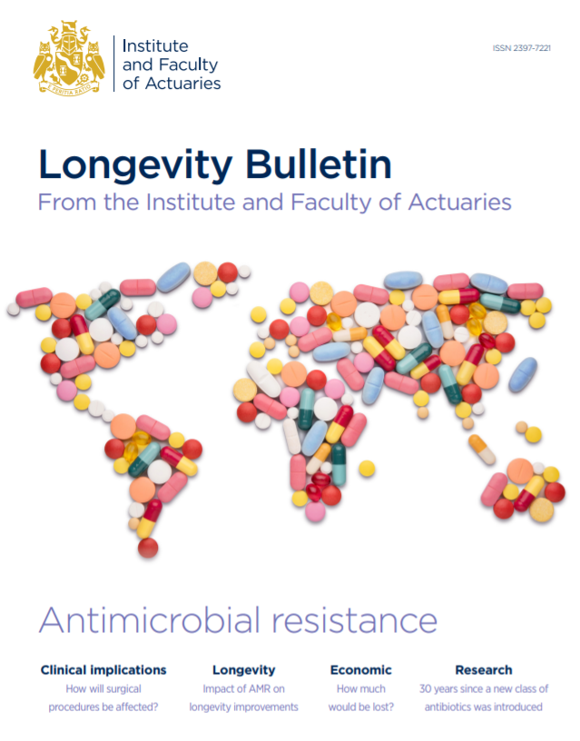
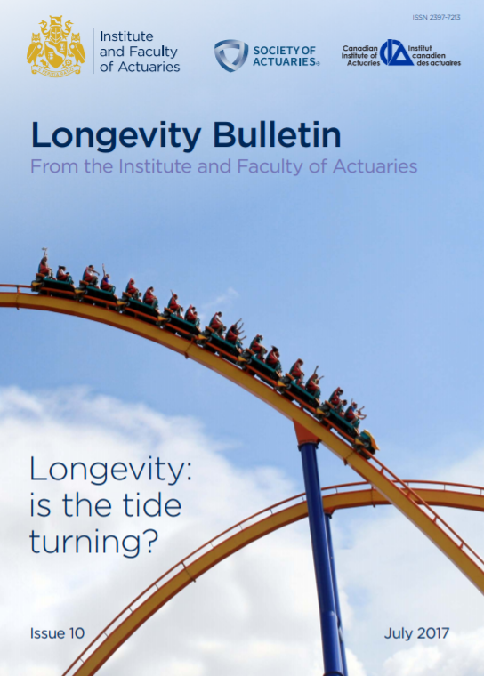

Longevity Bulletin

Slide 12

Longevity Bulletin – work in progress for next issue
Overall ‘pharma’ theme – insights into how pharmaceuticals help or hinder morbidity and mortality, and how to interpret the related research studies
Polypharmacy – Dr Malcolm Kendrick
Statins (IFoA ARC research) – Prof Elena Kulinskaya
Diabetes – Nicola Oliver (Diabetes WP Chair)
‘Researching Research’ – Matthew Edwards, Daniel Ryan
UK opioids – Dr Chris Martin
Antibiotic Resistance – IFoA ABR Working Party conclusions
Future issues?
Let us know your ideas …

Slide 13
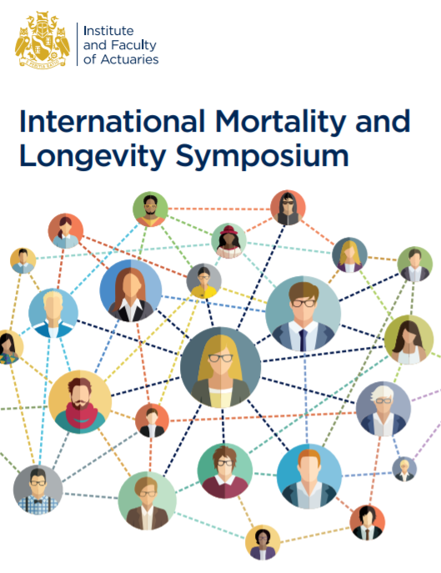
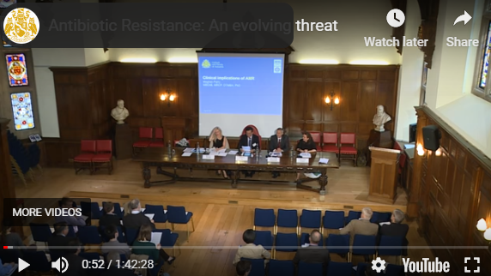
Events
We also run smaller ‘ad hoc’ events on matters of particular interest – eg ABR evening event at Staple Inn
(below, 2016)
What events would you find useful?
What format would you find most useful?

Slide 14
Research Priorities

Slide 15
Research Priority Principles
Address “real” challenges

Slide 16
Research Priority Principles
Address “real” challenges
Focus on “Next Generation” solutions

Slide 17
Research Priority Principles
Address “real” challenges
Focus on “Next Generation” solutions
Profession or Industry level endeavours

Slide 18
Research Priority Principles
Address “real” challenges
Focus on “Next Generation” solutions
Profession or Industry level endeavours
Enhance the Profession's reputation

Slide 19
Introduction to Priorities
The following areas are proposed to be the research priorities that the MRSC will focus on:
Predicting future population mortality improvement
Forecasting trends in morbidity
Supporting the Profession's efforts to resolve the challenge of providing older age care
Managing risk in products providing longevity protection
Tools and techniques used for analysing portfolio experience
Communication of complex risk behaviours in ways that are easy to understand

Slide 20
Predicting future population mortality improvement
Intention is to create a method for calibrating the CMI model to create a prediction of population mortality improvement involving the aspects of:
Data and Model Structure
Information and Expert Opinion
Calibration Methodology
Communication Method

Slide 21
Forecasting trends in morbidity
Consult
Define
Steer
Review
Adapt
We propose a cyclical approach to afford more informed and relevant steering guidance and research output
What: perform consultations with stakeholders (stakeholder events, surveys, interviews, round tables etc)
Consult
Why: to canvass stakeholder views on actuarial research needs related to morbidity trend risk to feed into work being initiated by the Mortality & Morbidity Research Steering Committee (‘MRSC’) of the IFoA
What: draft a Morbidity Research Needs Analysis Report summarising findings back to the MRSC
Define
Why: to provide a firm basis to draft proposals for focus areas, output mechanisms, and any wider steering decisions to better meet identified needs and report these back to the MRSC to agree on next steps
What: co-ordinate the commissioning of morbidity research steering guidance through the MRSC, in collaboration with associated bodies and aligned to the conclusions of the consultations
Steer
Why: to meet our mission statement objectives of leading world class research and acting as a conduit for research activity

Slide 22
Supporting the Profession's efforts to resolve the challenge of providing older age care
How should the UK resolve the challenge of providing older age care?
What role should the insurance industry or pension schemes play in resolving this challenge?
What role should the profession play in resolving this challenge?
What should the MRSC be doing to support this?

Slide 23
Managing risk in products providing longevity protection
Produce a paper or set of papers on Longevity Risk Management covering:
Creation of an industry standard definition of the risk behaviours comprising longevity
Development of a generic standard method for measuring longevity risk
Identification of new ways to reduce risk
Expansion of the consideration of the different risk affecting different types of annuitants – standard, impaired and deferred annuitants

Slide 24
Portfolio Analysis
PORTFOLIO DATA
ANALYSIS
MORTALITY BASIS
… or morbidity or other dec.’s? …
CONTEXT:
TECHNIQUES? – AvE, GLM/Survival, machine learning … other? …
Data enrichment (and related issues around postcode eg grouping methods)
Proxies (eg postcode for postcode rating)
Uncertainty / credibility / model risk
Implicit assumptions made – eg homogeneity – problems with dispersion?
Time units – is a year still adequate for high ages?
Selection effects

Slide 25
Communication of complex risk behaviours in ways that are easy to understand
Not as simple as “Level” – demographic assumptions have many vectors such as “Trend”, “Shape” and “Classification”
These effect not only the “reserve” but also the “risk”
Overly Simple (EoL) vs Hard to Interpret (Heat maps)
The intention is to commission a paper that will consider:
  The ideal properties that a metric or metrics should have
  A critique of the current available measures against these properties
  Consider possible new or alternative metrics
  Assess the use of benchmarking for best estimate and risk calibrations used in the industry and by the regulator

Slide 26
Road Map
Consultation And Scope Definition
Commissioning
Research and Development
Review and Refinement
Publication
2019
2020
We are here!
2021

Slide 27
How do you get involved?

Slide 28
Member Interest Group

Slide 29
Member Interest Group
Community

Slide 30
Member Interest Group
Community
Communication

Slide 31
Member Interest Group
Community
Communication
Discussion Forum

Slide 32
Member Interest Group
Community
Communication
Discussion Forum
Opportunities

Slide 33
Longevity Bulletin Assistant Editor
Volunteer Vacancy to support Matthew Edwards who acts as editor of the Longevity Bulletin
Awareness of demographic risk is required but expert knowledge is not
Need a volunteer to provide the momentum to deliver the Longevity Bulletin twice a year

Slide 34
MRSC Assistant
Dog’s Body required!
Attend the MRSC meetings
Gain access and exposure to some of the leading Demographic Risk Actuaries in the profession

Slide 35
Summary of Presentation
The MRSC is responsible for guiding the profession’s management of Demographic Risks into the 21st Century
Our research priorities aim to tackle the most significant challenges facing actuaries in managing mortality, morbidity and longevity risk
There are many ways for you to get involved!

Slide 36
Thank you
Any questions?

