Slide 1
The ECJ Gender Directive
One year on
Tuesday 1st April 2014
Staple Inn, London
lionel.texier@riskandanalysis.com
Roshni.Bhudia.1@cass.city.ac.uk
Lionel Texier – Managing Director R&A
Roshni Bhudia – Trainee R&A
Magalie Jousset – Trainee R&A

Slide 2
EU Gender Directive
Test-Achats Case
EU Guidelines
Expected impact of Unisex Pricing
Impact assessment of the ban on gender-based pricing
Unisex pricing in the UK
A brief overview of other EU countries : Fr., Bel. & Lux.
One year on, our prospective
Conclusion

Slide 3
Fact trigger
53% of people did not know the gender ruling was happening
Just under 45% believed that they had been unfairly discriminated against
18% of women considered this ruling acceptable
45% of men were unclear about the impact of the gender directive
16% of men thought their premiums would increase
http://www.confused.com/car-insurance/articles/eu-gender-ruling-your-need-to-know-guide-to-insurance-price-rises
http://www.postonline.co.uk/post/analysis/2287745/gender-directive-new-tricks

Slide 4
EU Gender Directive
Test-Achats Case
EU Guidelines
Expected impact of Unisex Pricing
Impact assessment of the ban on gender-based pricing
Unisex pricing in the UK
A brief overview of other EU countries : Fr., Bel. & Lux.
One year on, our prospective
Conclusion

Slide 5
EU Gender Directive
Premiums must be based on "relevant and accurate actuarial and statistical data" (section 13(3ai) e)
Insurance companies are prohibited to support sexual discrimination in their policies since 21st December 2012
Before this date, insurance companies were given a short period of time to prepare and adjust to this ruling

Slide 6
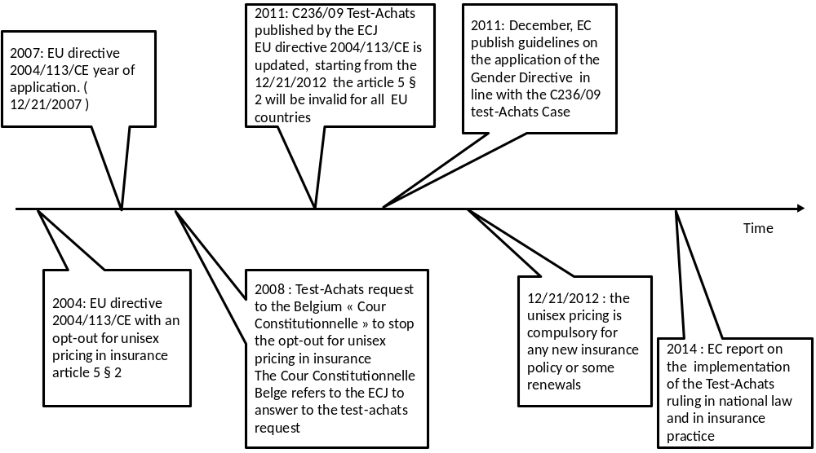
EU Gender Directive

Slide 7
EU Gender Directive
Test-Achats Case
EU Guidelines
Expected impact of Unisex Pricing
Impact assessment of the ban on gender-based pricing
Unisex pricing in the UK
A brief overview of other EU countries : Fr., Bel. & Lux.
One year on, our prospective
Conclusion

Slide 8
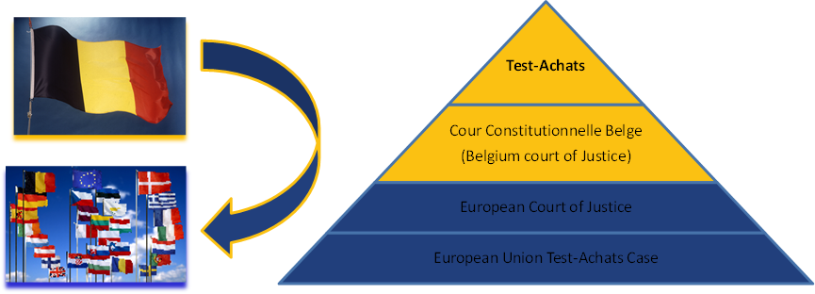
Test-Achats Case
Belgian consumer organization that challenged the Gender Directive 2004/113/EC article 5(2) of the European Union. The European Court of Justice (ECJ) passed down its ruling on a case regarding a provision of the Directive. There has been no appeal against this ruling.
Figure 2 : The Test-Achats case, from Belgium to the EU - Credits © European Union 2013

Slide 9
EU Gender Directive
Test-Achats Case
EU Guidelines
Expected impact of Unisex Pricing
Impact assessment of the ban on gender-based pricing
Unisex pricing in the UK
A brief overview of other EU countries : Fr., Bel. & Lux.
One year on, our prospective
Conclusion

Slide 10
EU Guidelines
The contracts concerned are:
  Contracts concluded after 21 December 2012. Therefore, offers made before 21st December 2012 but accepted as from that date will need to comply with the unisex rule
  Agreement to extend contracts concluded before that date which would otherwise have expired
It is still possible to collect, store and use gender data for:
  Reserving and internal pricing
  Reinsurance pricing
  Marketing and advertising
  Possible to offer gender-specific insurance products (or options within contracts) to cover conditions, which exclusively or primarily concerns males or females (prostate cancer, uterus cancer, breast cancer…)
  Using risk factors

Slide 11
EU Guidelines
Scope of the Directive:
The Directive only covers insurance and pension which are private, voluntary and separate from the employment relationship (it excludes group health and accident contracts and occupational pensions covered by Directive 200/54/EC).
Monitoring of the guidelines:
The commission will:
Make sure that all the EU member states comply to the Directive and the guidelines that started from the 21st December 2012 by adapting their legislation
Remain vigilant to detect any unjustified rise in prices or anti-competitive conduct
Report on the implementation of the Test-Achats ruling in 2014

Slide 12
The situation by country before the 21st of December 2012 (source: EU Test-Achats guidelines)
 | Country | UK | France | Belgium | Lux. | Nether. | Cyprus | Bulgaria | Slovenia
 | Life Insurance | YES | YES | YES | YES | YES | YES | YES | YES
 | Private health insurance | YES | YES | NO | YES | NO | NO | YES | YES
 | Mortgage loans | N/A | N/A | NO | N/A | NO | NO | N/A | N/A
 | Motor Insurance | YES | YES | NO | YES | NO | NO | NO | NO
 | Travel Insurance | YES | YES | NO | YES | NO | NO | N/A | N/A
 | Disability/Income insurance | YES | YES | NO | YES | NO | NO | N/A | YES
 | Consumer credit | N/A | N/A | NO | N/A | NO | NO | N/A | N/A
 | Annuity products | YES | YES | YES | YES | NO | YES | N/A | YES
 | Accident insurance | YES | YES | NO | YES | NO | YES | NO | YES
 | Credit cards | N/A | N/A | NO | N/A | NO | NO | N/A | N/A
 | Deposit accounts | N/A | N/A | NO | N/A | NO | NO | N/A | N/A
 | Loan insurance | YES | YES | NO | YES | NO | N/A | N/A | N/A
 | Home insurance | YES | YES | NO | YES | NO | NO | N/A | N/A
 | Private liability insurance | YES | YES | NO | YES | NO | NO | N/A | N/A
 | Long term care insurance | YES | YES | NO | YES | NO | NO | N/A | YES
 | Critical illness insurance | YES | YES | NO | YES | NO | NO | YES | YES

Slide 13
The situation by country after the 21st of December 2012
 | Country | UK | France | Belgium | Lux. | Nether. | Cyprus | Bulgaria | Slovenia
 | Life Insurance | NO | NO | NO | NO | NO | NO | NO | NO
 | Private health insurance | NO | NO | NO | NO | NO | NO | NO | NO
 | Mortgage loans | NO | NO | NO | NO | NO | NO | NO | NO
 | Motor Insurance | NO | NO | NO | NO | NO | NO | NO | NO
 | Travel Insurance | NO | NO | NO | NO | NO | NO | NO | NO
 | Disability/Income insurance | NO | NO | NO | NO | NO | NO | NO | NO
 | Consumer credit | NO | NO | NO | NO | NO | NO | NO | NO
 | Annuity products | NO | NO | NO | NO | NO | NO | NO | NO
 | Accident insurance | NO | NO | NO | NO | NO | NO | NO | NO
 | Credit cards | NO | NO | NO | NO | NO | NO | NO | NO
 | Deposit accounts | NO | NO | NO | NO | NO | NO | NO | NO
 | Loan insurance | NO | NO | NO | NO | NO | NO | NO | NO
 | Home insurance | NO | NO | NO | NO | NO | NO | NO | NO
 | Private liability insurance | NO | NO | NO | NO | NO | NO | NO | NO
 | Long term care insurance | NO | NO | NO | NO | NO | NO | NO | NO
 | Critical illness insurance | NO | NO | NO | NO | NO | NO | NO | NO

Slide 14
EU Gender Directive
Test-Achats Case
EU Guidelines
Expected impact of Unisex Pricing
Impact assessment of the ban on gender-based pricing
Unisex pricing in the UK
A brief overview of other EU countries : Fr., Bel. & Lux.
One year on, our prospective
Conclusion

Slide 15
Expected impact from Unisex Pricing
Risk based pricing
Gender is used for accuracy of pricing premiums that cover these risks.
Setting low premiums for a risky consumer, insurers employ a higher risk consumer group of which the policy can be underpriced
Since one group of consumers benefit from the ban, then it will always make the other group worse off
The lower risk gender may opt out and the higher risk gender may opt in which in turn, will create more riskiness in the market

Slide 16
Expected impact from Unisex Pricing
Life insurance
Life insurance premiums for new policies were expected to leap by up to a third towards the end of 2012
Premiums have fallen over the past decade, and expected to rise after the Directive
Premiums for women were likely to rise significantly
According to Confused.com, they expected that women could end up paying around 20 per cent more for life insurance as a result
A study from Oxera predicted “on average women (aged 40) could see life insurance premiums rise by around 30% or more”
http://www.confused.com/life-insurance/articles/gender-equality-ruling-cost-of-life-insurance-for-women-to-rise
http://www.oxera.com/Oxera/media/Oxera/downloads/Agenda/Gender-in-insurance-market.pdf?ext=.pdf

Slide 17
Expected impact from Unisex Pricing
Annuities and pensions
An annuity converts a pension pot into income, which is received annually. Not include occupational pension schemes
If you are a male considering purchasing an annuity with your pension pot, you are likely to get a more attractive pension than a woman of your age
‘Which?’ - Their general consensus was that women’s annuity income will rise by 2.5% and that men’s will fall by 2.5%
‘ABI’ - They predicted an 8% decrease for men and a 6% increase for women

Slide 18
Costs
Eliminating gender is very costly and these costs are transferred to clients through higher premiums, even if the concurrence may moderate this impact for clients
Invest their time and money into re-pricing, altering and printing of updated documents and training their staff as a result of the ban
Insures will also have to boost the amount of capital reserves to protect them against any future financial crises, further pushing premiums

Slide 19
Economic uncertainty
European crisis i.e. in Greece and Italy
People have less disposable income so they have had to sacrifice luxuries
Competition

Slide 20
EU Gender Directive
Test-Achats Case
EU Guidelines
Expected impact of Unisex Pricing
Impact assessment of the ban on gender-based pricing
Unisex pricing in the UK
A brief overview of other EU countries : Fr., Bel. & Lux.
One year on, our prospective
Conclusion

Slide 21
Statistics
only women aged 17-20 have seen a rise in their premiums, and that was only £9 (£1,706 in November 2013 compared with £1,697 in November 2012)
Men of the same age have seen a drop in prices, with the average premium now coming in at £2,358, as compared with £3,293 (a reduction of £936)
Women overall have seen a fall in premiums of £59
http://www.gocompare.com/covered/2013/12/the-eu-gender-directive-one-year-on/

Slide 22
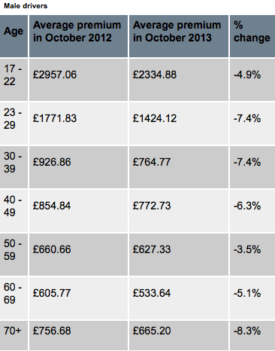
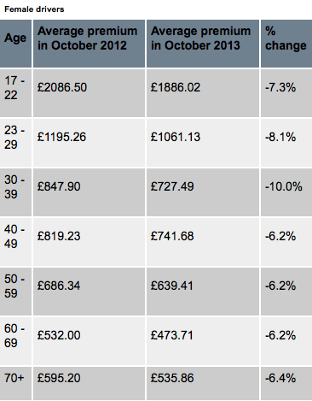
Impact assessment
Premium changes following the Gender Directive: http://www.postonline.co.uk/post/analysis/2321740/gender-directive-one-year-on

Slide 23
The impact of the ban on gender-based pricing
Motor insurance
AA insurance premium index announced at the end of January 2013:
“There was a 42% increase in the average best premium for 17-18 year-old female drivers since 1st December 2012, while premiums for 17-18 year-old males decreased by 17% in the same period”

Slide 24
Impact assessment
Life insurance
‘Zurich’ - Coupled with changes to life office taxation, it has meant an increase in prices of some 15-20 per cent for 2013
It is harder to switch existing cover on price because rates have recently risen
Annuities and pensions
Annuity rates have said to decline for males, but female annuity rates are said to have improved
In the second half 2012 an increasing number of men bought an annuity before the Gender Directive came into force
Increase in the number of men bringing their retirement forward to benefit from pre-Gender Directive annuity rates
http://www.ftadviser.com/2013/02/07/insurance/life-assurance/how-the-new-eu-gender-directive-has-affected-life-insurance-SONEHl1gp4bNr0fTDbHk6L/article.html
http://www.aviva.co.uk/media-centre/story/17233/the-surprising-effect-of-the-eu-gender-directive-o/

Slide 25
Impact assessment
Although consumer impacts are clearly adverse, and any available data has supported the central assumptions, quantitative calculations are based on very limited sources of data. We will seek to build a more complete set of data on which to base any calculations during the subsequent consultation phase

Slide 26
Niche markets
Sheilas’ wheels and Diamond, target women which may not be so unique anymore because they now pay the same premiums as male drivers
‘1st for women’ is a South African insurance company appealing to women. They effectively target the female market because in their advertisements, they convey the message that women are generally more responsible
http://www.youtube.com/watch?v=k8EEy5dhJWc

Slide 27
EU Gender Directive
Test-Achats Case
EU Guidelines
Expected impact of Unisex Pricing
Impact assessment of the ban on gender-based pricing
Unisex pricing in the UK
A brief overview of other EU countries : Fr., Bel. & Lux.
One year on, our prospective
Conclusion

Slide 28
The situation in the UK market
The search to find alternative sets of data has become more difficult for underwriters assessing the risks
It has become clear that consumers are not really benefiting from this law by a great deal
It is likely that insurers are experiencing unpredictability in their pricing grounds as this law makes its impact
The gender directive has so far, had a positive effect in terms of ethics, culture and fairness as a principle
There are winners and losers

Slide 29
EU Gender Directive
Test-Achats Case
EU Guidelines
Expected impact of Unisex Pricing
Impact assessment of the ban on gender-based pricing
Unisex pricing in the UK
A brief overview of other EU countries : Fr., Bel. & Lux.
One year on, our prospective
Conclusion

Slide 30
France
3 categories of insurance companies with 3 different laws impacted
Non-life insurance similar to the UK
Life insurance:
  The mortality table used to define the premium must be at least the most prudent between the official female/male mortality tables provided by the French Institute of Statistics (INSEE) given the guarantee
  The French law also mentions that insurance companies must payback at least 90% of the technical profit to policyholders. For instance, if one year there are less death claims benefits than expected in the premium, the insurer will payback at least 90% of the extra-premium (through for instance an increase of the sum insured)
  It is possible to use a certified mortality table based on a weighted average between female and male mortality tables if and only if it is more prudent than the most prudent between the official female/male mortality tables

Slide 31
Belgium
Unisex pricing in non-life insurance was already applied before the Test-Achats Case
In Life insurance:
  For life guarantees : mortality table equals or not higher than the XR table (based on a 50/50 average of the MR-FR tables)
  For death cover : mortality table equals or not lower than the XK table (based on a 50/50 average of the MK-FK table)
All the stakeholders were consulted in the implementation of the Test-Achats Case for the law
Some disagreement remains about the impact and the equality of this new law between the stakeholders

Slide 32
Luxembourg (mainly freedom to provide services across EU)
Up to june 2013, the project of law was not inverted yet (because it is complex to impact all the laws related to this), but insurers apply the supervisors guidelines that are in line with the EU directive and guidelines
Non-life insurance Similar to the UK
In Life insurance:
  Unisex mortality table for pricing
  Reserving based on the Unisex Mortality table used for pricing or not:
    If not the national supervisor provides very detailled guidelines to calculate reserves by using female/male or weighted average mortality table

Slide 33
EU Gender Directive
Test-Achats Case
EU Guidelines
Expected impact of Unisex Pricing
Impact assessment of the ban on gender-based pricing
Unisex pricing in the UK
A brief overview of other EU countries : Fr., Bel. & Lux.
One year on, our prospective
Conclusion

Slide 34
Gender gap is not homogeneous in EU
Figure 7: Gender Gap (Women – Men) in life expectancy at age 65 1998 & 2011 in years - Source : Eurostat [demo_mlexpec]

Slide 35
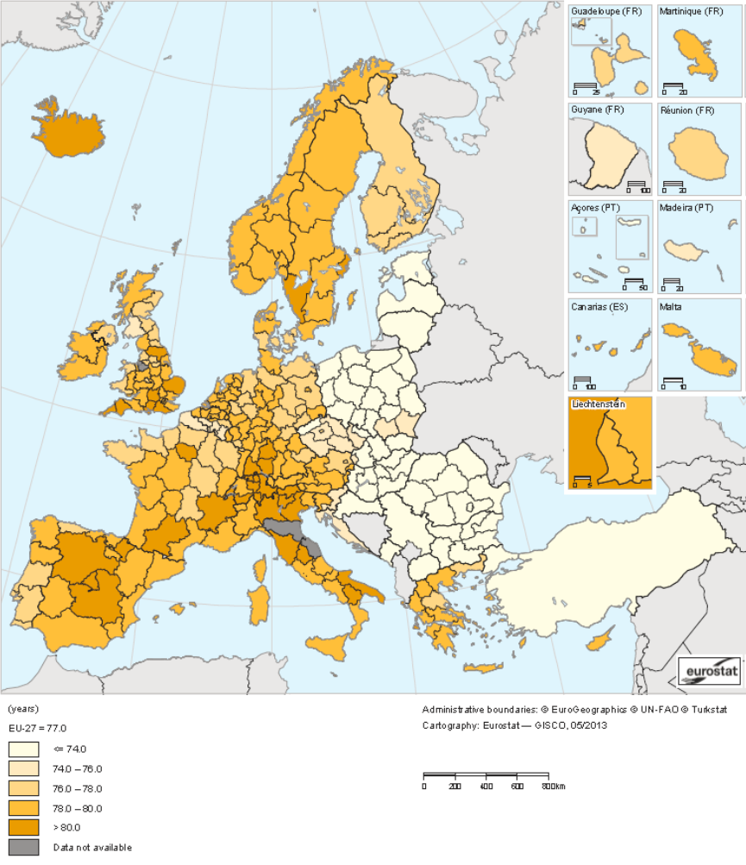
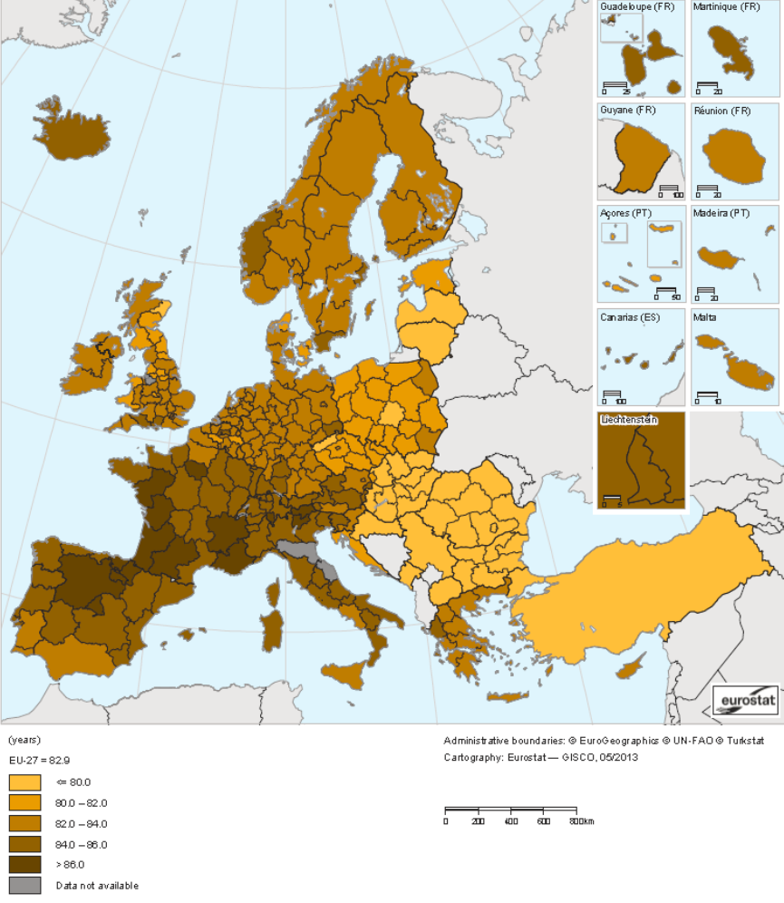
Gender gap is not homogeneous in EU
Life expectancy at birth, male 2011 - Source Eurostat Atlas
Life expectancy at birth, female 2011 - Source Eurostat Atlas

Slide 36
France gender gap projection
Figure 6 : Life expectancy at birth time serie and projection by gender in France - Source: INSEE, estimation de population et statistiques de l'état civil et projection de population 2007-2060

Slide 37
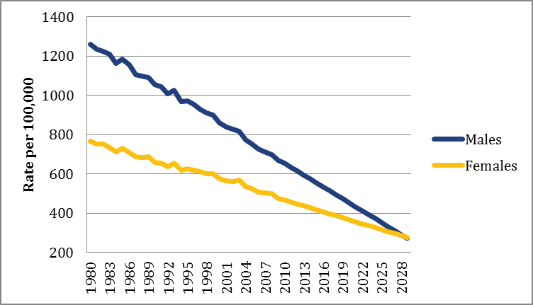
UK gender gap projection
Figure 5 : UK mortality rates prediction 1980-2030 - Source: Office for National Statistics

Slide 38
Consumer will be more and more well-informed
Comparison website for insurance product become very important and consumers are more and more confortable to compare prices
Step by step the range of insurance product the consumers can compare online is increasing:
  The FCA published a report and make recommendations to incent consumer to compare annuity prices
  In France, an aggregator dedicated to annuity and pensions was launched in 2014 : www.comparetraite.fr
Consumers do not only compare the prices but also the services thanks to website like www.quialemeilleurservice.com provided by Axa in France
The insurance industry will have to adapt to this new period where the competition is higher and the product design and pricing model will change more frequently than before

Slide 39
EU Gender Directive
Test-Achats Case
EU Guidelines
Expected impact of Unisex Pricing
Impact assessment of the ban on gender-based pricing
Unisex pricing in the UK
A brief overview of other EU countries : Fr., Bel. & Lux.
One year on, our prospective
Conclusion

Slide 40
Conclusion
It is difficult to assess the impact of the Test-Achats case on the market
A common rule for an heterogeneous situation in EU
At the same time, some US insurers ban unisex pricing for long-term care insurance
Big data, telematics, predictive analytics: gender is just an element of a wider question about insurance principles based on statistical discrimination versus ethics

Slide 41
Questions?

