Slide 1

Analysing Analytics
Matthew Edwards, Rachael McNaughton
SIAS – 5 June 2018

Slide 2
Disclaimer
The views expressed in this presentation are those of the authors,
Matthew Edwards and Rachael McNaughton,
of the paper and not necessarily of the
Staple Inn Actuarial Society
or their employer, Willis Towers Watson

Slide 3


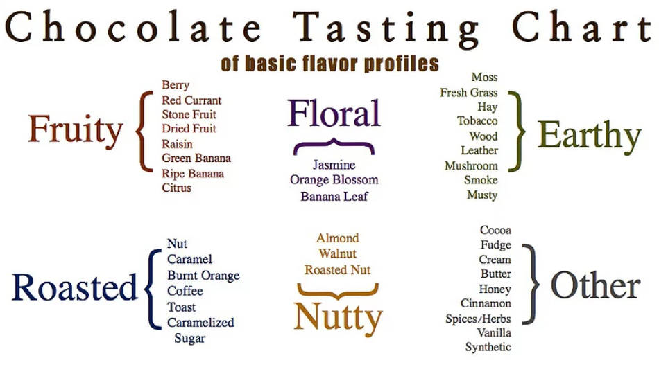
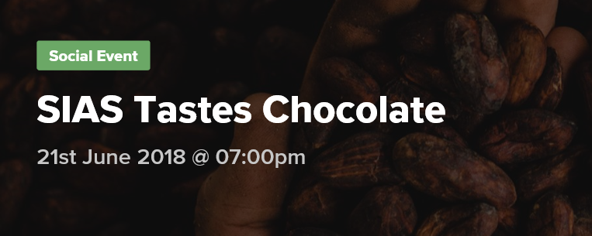
The (best) analytic journey
Data
Method
Result

Slide 4

Introduction
Volume
Variety
Velocity
Veracity

Slide 5
Direction of travel (1)
‘Normal’ modelling
Cause
Effect
    ‘Understanding cause is the fundamental goal of science’ - Briggs
    Models traditionally constructed around some conception of causality
    eg mortality as a function of age, gender
    More complex models continue this philosophy
      eg q = f(age, sex, postcode, amount …)
    Essential characteristic of this model – there is an underlying theory
    NB the theory itself may be very loose (eg age in above models – it’s just a proxy)
    Also called ‘generative’ models

Slide 6
Tangent to direction of travel ….
    Bradford Hill criteria for causality in the absence of well-understood theory
    Strength (effect size): A small association does not mean that there is not a causal effect, though the larger the association, the more likely that it is causal.
    Consistency (reproducibility): Consistent findings observed by different persons in different places with different samples strengthens the likelihood of an effect.
    Specificity: Causation is likely if there is a very specific population at a specific site and disease with no other likely explanation.
    Temporality: The effect has to occur after the cause (and if there is an expected delay between the cause and expected effect, then the effect must occur after that delay).
    Biological gradient (ie dose response relationship): Greater exposure should generally lead to greater incidence of the effect. However, in some cases, the mere presence of the factor can trigger the effect (like a catalyst). Or, an inverse proportion may be observed.
    Plausibility: A plausible mechanism between cause and effect is helpful (but Hill noted that knowledge of the mechanism is limited by current knowledge).
    Consistency … between epidemiological and laboratory findings increases the likelihood of an effect (eg clinical findings)
    Experiment: ‘Occasionally it is possible to appeal to experimental evidence’.
    Analogy: The effect of similar factors?

Slide 7
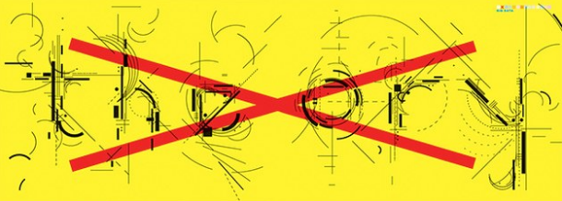
What to do with lots of data …
‘Google's founding philosophy is that we don't know why this page is better than that one: If the statistics of incoming links say it is, that's good enough. [There is] no … causal analysis.’
‘Forget taxonomy, ontology, and psychology. Who knows why people do what they do? The point is they do it, and we can track and measure it with unprecedented fidelity. With enough data, the numbers speak for themselves.’
‘Petabytes allow us to say: "Correlation is enough.” We can stop looking for models. …
We can throw the numbers into the biggest computing clusters the world has ever seen and let statistical algorithms find patterns where science cannot.’
Chris Anderson, Wired 2008

Slide 8
Direction of travel (2)
‘Big data’ analytics
Factor 1
Factor 2
…
Factor i
Effect
    Given some observed effects and a large number of possibly explanatory factors, we look for those that might be material under various plausible model structures
    The ‘effect’ may be quite broad – eg rather than binary outcome (buys or does not buy a new policy), could relate to character recognition
    This is the opposite of causative reasoning – we are simply finding associations (correlations)

Slide 9
Understanding reality
    ‘I would rather discover one causal law than gain the kingdom of Persia’ Democritus
    Can big data solve the fundamental problem of causal inference?
      ‘Big data can enhance and deepen our ability to explore and develop scientific explanations’
      ‘The availability of big data per se does not constitute a structural breakthrough in our ability to make causal inferences’
      ‘The need for critical thinking will be stronger the more we become inundated with ever-larger amounts of new information’
      (Rocio Titiunik)
    ‘Causal inference and data science’ – Jennifer Hill
    ‘Data science needs causal inference to prevent data scientists from saying silly things and making recommendations that could be problematic’
    ‘Big data … can actually exacerbate the problem. If we have a poor design/use inappropriate methods/don’t think hard about the assumptions, more data will simply make us more confident about our incorrect inference.’
    There are ways to combine the two camps – ie to conduct ‘big data’ analyses in ways that involve causal inference

Slide 10
Comparison of approaches
Causal model | ‘Big data’ / advanced analytics approach
What are the causes? – how do we go from cause to effect? = epistemology | All about effects (and thus predictions) – who cares about causes? = ontology
Likely to aid understanding where simple causality already known | Helps to discover possible (currently unknown) causality
Simple / transparent | Complex / ‘black box’
More ‘qualitative’ rigour around factor inclusion? (eg along lines of BH criteria) | Factors / models decided in more ‘algorithmic’ approach
Required to achieve counterfactual fairness | Ignores counterfactuals (but implicitly allowed)
More applicable to stress uses?
 | Confuse association with causation? (may not be a predictive problem, but ethical problem?)
Also various obvious points re computational speed, data requirements …

Slide 11
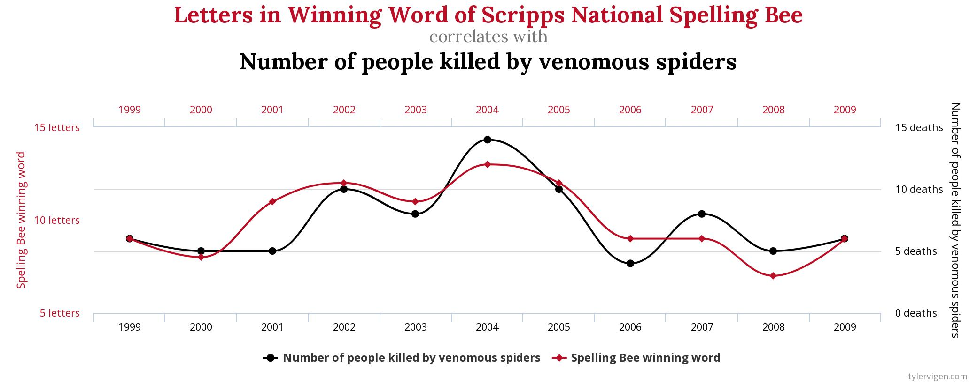
Interesting correlations
http://www.tylervigen.com/spurious-correlations

Slide 12
Expert judgement
    To the extent that ‘big data’ work is less concerned about underlying causes, it will be less predictive as things change – hence greater need for expert judgement
    Several areas where expert judgement is essential:
      Trends over time – ie from period of data to period of application
      Extrapolation beyond well-populated data ranges
      Reasonableness of results
      ‘Common sense’ / regulatory / conduct constraints
      Adjust parameterisation to allow for post-application gaming?
    The number of areas where expert judgment is required shows the danger of moving in this field without seeking to ‘understand reality’
Big Data processes codify the past. They do not invent the future. – O’Neill

Slide 13
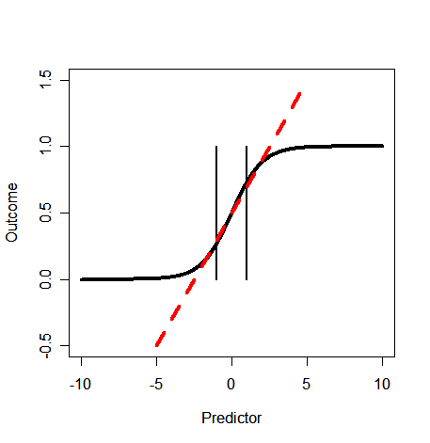
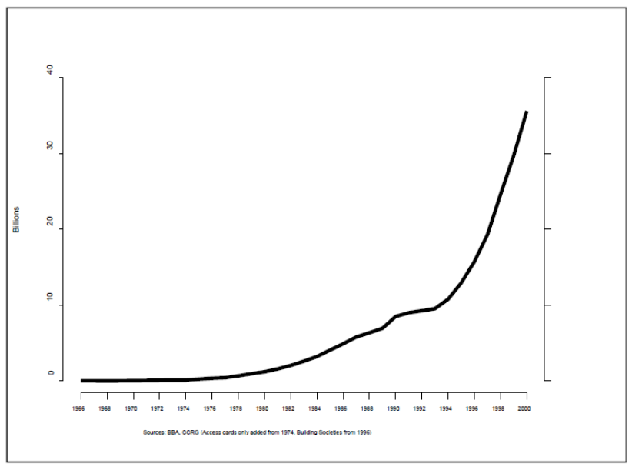
Expert judgement – trends
Trends over time
Going beyond data range

Slide 14
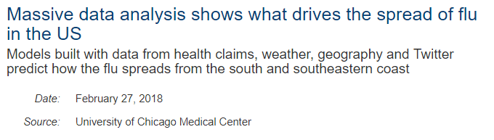
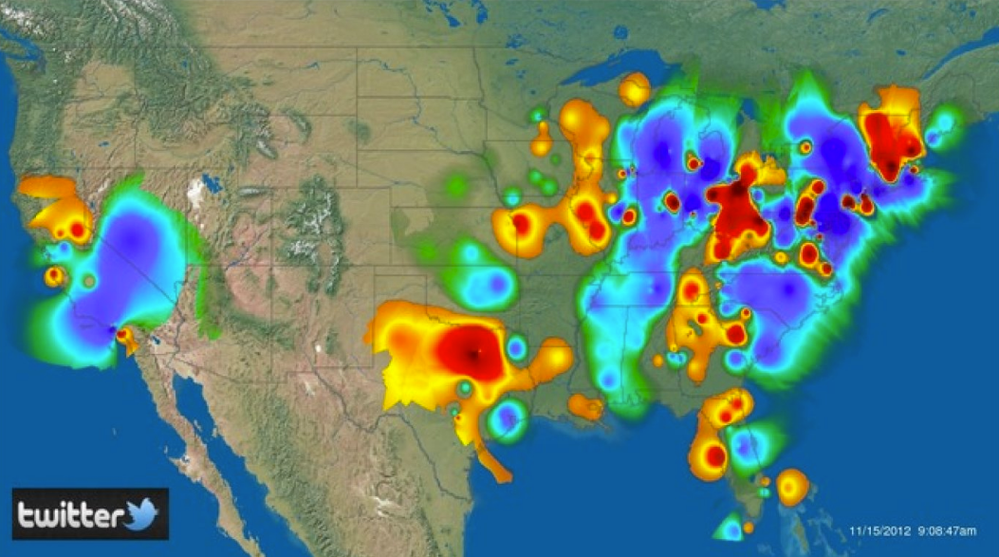
Data problems – selection bias?
    Recent examples
      Twitter analysis
      Anything based on smartphones!
    Sources of selection bias
      Natural mechanisms
      Non-response
      Self-selection
      Data dredging
      ‘Harking’
      Asymmetry
      Gaming the system
      Regression to the mean
‘Garbage in, garbage out’ → ‘Bias in, bias out’

Slide 15
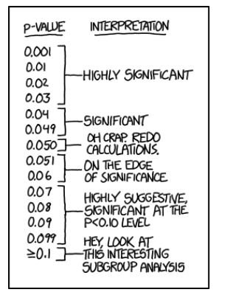
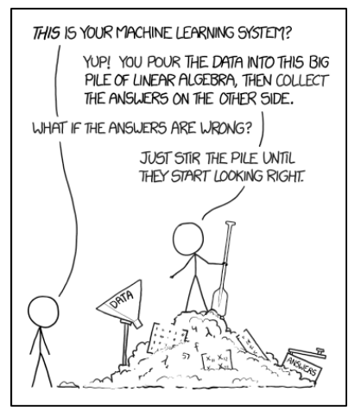
Selection bias (2)
Data dredging, ‘Harking’, Asymmetry
https://xkcd.com/1478 (etc)

Slide 16
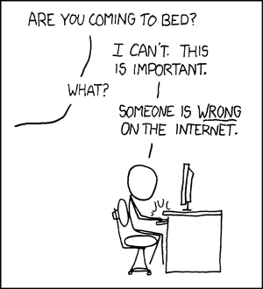
Adjustment – what to do when it goes wrong
    How quickly can we find out?
      Can you monitor with proxies before experience emerges?
    Is it really wrong?
    How much does it matter?
      Non-critical application
      Application may be important, but constraints might contain the variation
    How quickly can we adjust?
https://xkcd.com/386/
“Remember that all models are wrong; the practical question is how wrong do they have to be to not be useful” – George Box

Slide 17




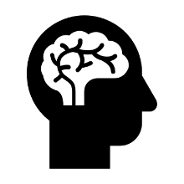

Application of results
“Any analysis should come after understanding what decisions will be made with the measurements” - Briggs
What are our objectives?
Optimise analytics
Measure success

Slide 18
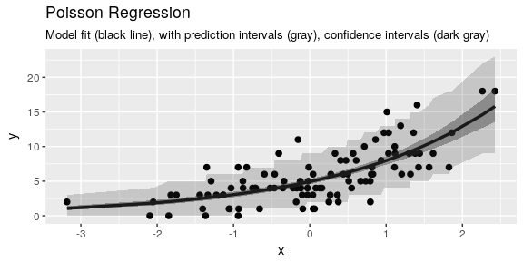
Overconfidence
Point estimates, confidence intervals and prediction intervals
Point Estimate: “My model says if x is this, y is that”
Confidence interval: “If x is this, then what the true model says is y is between these two values with 95% probability”
Prediction interval: “If x is this, then the probability y is between these two values is 95%”
Overconfidence

Slide 19
Overconfidence and overfitting
Measuring the wrong objective
Available data
Experimental Analysis
Train
Holdout
Train
Validate
Holdout (no cheating)
Train
Test
Validate
Cross Validation
Train/Test
Train/Test
Train/Test
Train/Test
“Proper” Cross Validation
Train/Test
Train/Test
Train/Test
Validate
“Traditional tricks like cross validation ... all cheat and reuse what is already known as if it were unknown, they repackage the old as new. The true and only test of model goodness is how well that model predicts data never before seen or used in any way.” - Briggs
Notes:
This can lead to overconfidence in two flavours – one, by reducing model performance to a set of numbers we trick our brain into ignorance, two, fundamentally we are using what is already known.

Slide 20

Algorithmic bias?
    ‘Square peg’ bias
      Model selected / designed for previous data
    ‘Wolf in sheep’s clothing’ bias
      Inappropriate metrics
    ‘Has-been’ bias
      Categorisations no longer fit new reality
    ‘Missing-wood-for-the-trees’ bias
      Vital aspect missing (eg major
      selection bias?)
    ‘Insatiable monster’ bias
      Erroneous extrapolation
      https://www.datascience.com/blog/sneaky-biases-in-algorithms

Slide 21

Ethics
What is “fair”?
    Ethics are not regulations
    Ethics are shared social values/rules that we agree to follow because of the shared benefits – what is fair?
    Definitions of fairness
Fairness Through Unawareness
Individual Fairness
Demographic Parity
Equality of Opportunity
Counterfactual Fairness
Notes:
Imagine a car insurance company wants to price insurance for car owners by predicting their accident rate with an algorithm. The company assumes that aggressive driving is linked both to drivers being more likely to have accidents and a preference for red cars.
Whilst it would seem that the company could use red car preference as a good way of predicting who will cause accidents, there could be other variables at play: for example, what if individuals of a particular race are more likely to drive red cars, but are no more likely to drive aggressively or have accidents? If, in an attempt to be fair, the company removed or ignored race from the decision-making process, they might only have directly observable factors, like red car preference, from which to make a decision, thereby including, rather removing, hidden racial biases.

Slide 22
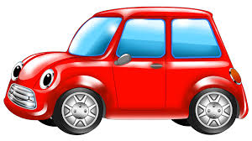
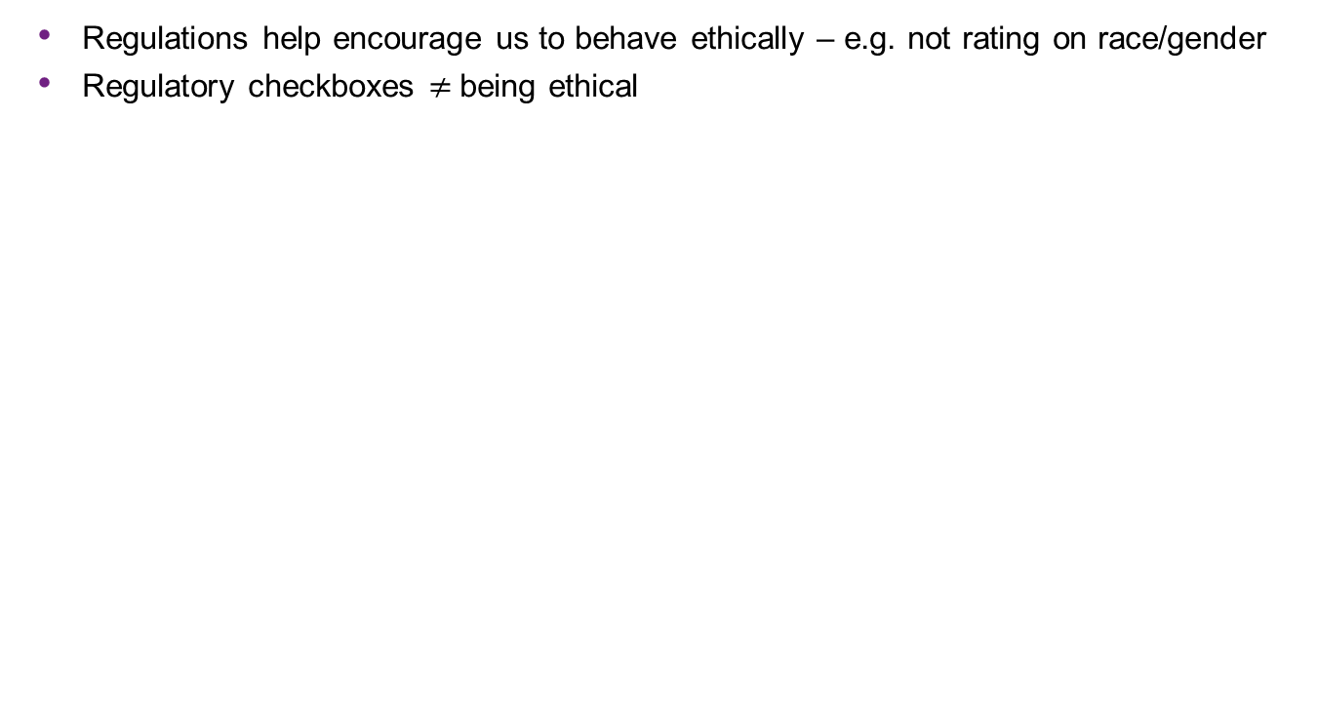
Ethics
    Regulations help encourage us to behave ethically – e.g. not rating on race/gender
    Regulatory checkboxes $≠$being ethical
“If we start leaving sensitive variables, like people’s race, out of our dataset, which some laws actually require, we can become unable to understand what the causes of certain observations are, and therefore unable to prevent bias against those sensitive attributes” – Joshua Loftus, NYU Stern
Scenario: The Red Car
“omitting race may introduce unfairness into an otherwise fair world”
Scenario from Kusner, Loftus, Russel, Silva: Counterfactual Fairness
Notes:
Imagine a car insurance company wants to price insurance for car owners by predicting their accident rate with an algorithm. The company assumes that aggressive driving is linked both to drivers being more likely to have accidents and a preference for red cars.
Whilst it would seem that the company could use red car preference as a good way of predicting who will cause accidents, there could be other variables at play: for example, what if individuals of a particular race are more likely to drive red cars, but are no more likely to drive aggressively or have accidents? If, in an attempt to be fair, the company removed or ignored race from the decision-making process, they might only have directly observable factors, like red car preference, from which to make a decision, thereby including, rather removing, hidden racial biases.

Slide 23
What could go wrong?
When and where could it go wrong?
Overfitting
Performs badly in some circumstances
Selection bias
Smoothing and / or distortion?
Model ‘wrong’ (bias)
Unethical
Data Choice
Data Prep
Analysis
Application
Misunderstood and so misapplied
Model becomes outdated
Feedback
Unexpected swings
Causes changes in behaviour

Slide 24
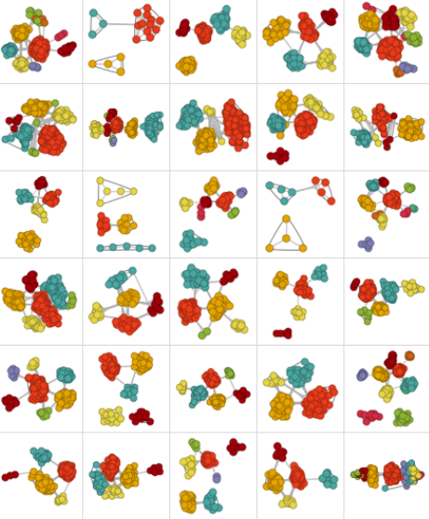
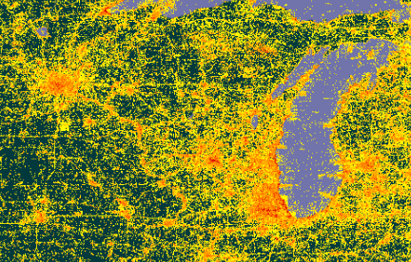
With great power …
‘We no longer have the capability to fully understand the output of the algorithms we have created.’ Sumpter
https://www.gbif.org and http://blog.stephenwolfram.com/2013/04/data-science-of-the-facebook-world

